Slide 1



AI-BASED WATER QUALITY PREDICTION AND
Contamination Classification Using Machine Learning
Presented By:
ABINISHASRI B - 927623BAD002
DHARSHINI K - 927623BAD023
GOPIKASRI T - 927623BAD037

Slide 2

ABSTRACT
Water pollution is a major environmental problem that affects human health and aquatic ecosystems. Traditional water quality testing is time-consuming and costly. This project proposes an AI-based system to predict water quality and classify contamination using machine learning algorithms such as Random Forest and XGBoost. Parameters like pH, TDS, turbidity, and hardness are used for analysis. The system classifies water into four categories: Good, Moderate, Poor, and Contaminated. An Android application displays prediction results, while Firebase stores previous records. This system aims to support faster water quality assessment and promote environmental protection. However, laboratory testing is still required to confirm drinking water safety.

Slide 3

LITERATURE REVIEW
Author & Year | Research Paper | Findings
Prasad et al. (2021) | Prediction on Water Quality of a Lake in Chennai, India Using Machine Learning Algorithms | Random Forest achieved 95% accuracy in the study.
Shams et al. (2024) | Water Quality Prediction Using Machine Learning Models Based on Grid Search Method | Model tuning improved classification performance; Gradient Boosting achieved 99.5% accuracy in the reported test results.
Sangwan & Bhardwaj (2024) | Machine Learning Framework for Predicting Water Quality Classification | Compared machine learning models for groundwater quality classification.
Kumar et al. (2020) | Machine Learning-Based Water Quality Prediction and Assessment | Machine learning techniques can analyse water quality parameters and help predict water quality conditions.

Slide 4
PROBLEM STATEMENT
  Groundwater depletion is caused by excessive extraction and insufficient recharge.
  Existing systems have limited future prediction capabilities.
  Early identification of high-risk districts is essential.
  An AI-based system can forecast groundwater levels and classify risks.

Slide 5

OBJECTIVE OF YOUR PROJECT
  Collect and analyze groundwater-level and rainfall data.
  Predict future groundwater levels using machine learning models.
  Identify high-risk areas using spatial interpolation techniques.
  Classify districts based on CGWB groundwater risk categories.
  Develop a dashboard to display groundwater status, forecasts, and early-warning alerts.
  Support sustainable groundwater management and environmental protection.

Slide 6
METHODOLOGY
  Data Collection: Obtain groundwater and rainfall data.
  Preprocessing: Clean data and handle missing values.
  Forecasting: Use XGBoost and time-series models.
  Spatial Interpolation: Apply Kriging.
  Risk Classification: Categorize districts using CGWB standards.
  Dashboard: Display trends, maps, and alerts.
  Evaluation: Measure performance using MAE and RMSE.

Slide 7
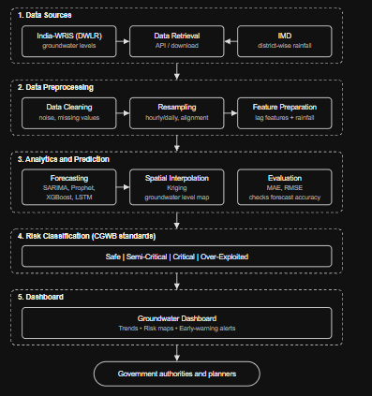

DESIGN LAYOUT

Slide 8
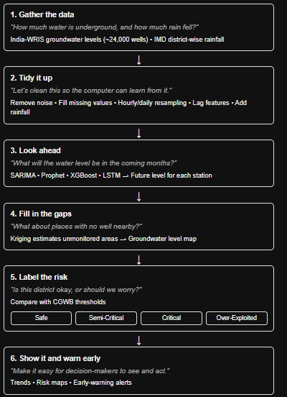
WORKFLOW

Slide 9
RESULT AND DISCUSSION
The proposed AI-Based Groundwater Depletion Early-Warning System aims to predict future groundwater levels using machine learning models and rainfall data. Spatial interpolation using Kriging helps estimate groundwater conditions in unmonitored areas. The system classifies districts into Safe, Semi-Critical, Critical, and Over-Exploited categories based on CGWB standards. The dashboard displays groundwater trends, risk maps, and early-warning alerts. The results can help identify potential groundwater depletion risks and support sustainable water resource management. The actual prediction accuracy will be evaluated using MAE and RMSE after model implementation and testing.

Slide 10
PROS AND CONS
Pros (Advantages)
  Predicts future groundwater levels using AI/ML models.
  Provides early warnings of groundwater depletion.
  Identifies high-risk areas using spatial interpolation.
  Classifies districts based on CGWB risk categories.
Cons (Limitations)
  Prediction accuracy depends on data quality.
  Missing or inconsistent data may affect results.
  Sparse monitoring stations may reduce mapping accuracy.
  Limited historical data may affect forecasting reliability.

Slide 11
COST ESTIMATION
  Estimated cost: ₹5,000–₹10,000
  Includes development, testing, data management, and documentation.
  Uses free, open-source software tools.
  No additional hardware or sensors are required.

Slide 12
CONCLUSION
The AI-Based Groundwater Depletion Early-Warning System uses machine learning to predict groundwater levels and identify depletion risks. It combines groundwater and rainfall data to forecast future changes and classify risk levels. The dashboard displays predictions and alerts to support early action. This project aims to promote groundwater conservation, sustainable water management, and environmental protection.

Slide 13
FUTURE SCOPE
In the future, this project can be expanded to cover more districts across India. Advanced machine learning models can improve groundwater-level prediction accuracy. Real-time monitoring, mobile applications, and automatic alerts can help identify depletion risks early. Additional data, such as soil conditions and land use, can improve risk analysis. This system can support government authorities in planning groundwater conservation and sustainable water management.

Slide 14
REFERENCES
  Kumar, A. S., & Vidhya, R. (2020). “Ensemble Based Groundwater Level Prediction Using Neural Network Pattern Fitting.” Indian Journal of Geo-Marine Sciences. Read paper
  Rahman, A. T. M. S., et al. (2020). “Multiscale Groundwater Level Forecasting: Coupling New Machine Learning Approaches with Wavelet Transforms.” Advances in Water Resources. Read paper
  Nistor, M. M., et al. (2020). “Investigation of Groundwater Table Distribution Using Borehole Piezometer Data Interpolation: Case Study of Singapore.” Engineering Geology. Read paper
  Malakar, P., & Mukherjee, A. (2021). “Deep Learning-Based Forecasting of Groundwater Level Trends in India: Implications for Crop Production and Drinking Water Supply.” ACS ES&T Engineering. Read paper

Slide 15
REFERENCES
5.Gupta, S. K., Sahoo, S., Sahoo, B. B., Srivastava, P. K., Pateriya, B., & Santosh, D. T. (2024). “Prediction of Groundwater Level Changes Based on Machine Learning Technique in Highly Groundwater Irrigated Alluvial Aquifers of South-Central Punjab, India.” Physics and Chemistry of the Earth, Parts A/B/C. Read paper
6.Sarkar, H., Goriwale, S. S., Ghosh, J. K., Ojha, C. S. P., & Ghosh, S. K. (2024). “Potential of Machine Learning Algorithms in Groundwater Level Prediction Using Temporal Gravity Data.” Groundwater for Sustainable Development. Read paper
7. Ruybal, C. J., et al. (2019). “Evaluation of Groundwater Levels in the Arapahoe Aquifer Using Spatiotemporal Regression Kriging.” Water Resources Research. Read paper
8.Varouchakis, E. A., Theodoridou, P., & Karatzas, G. (2020). “Decision-Making Tool for Groundwater Level Spatial Distribution and Risk Assessment Using Geostatistics in R.” Journal of Hazardous, Toxic, and Radioactive Waste. Read paper

Slide 16
THANK YOU

